Slide 1



Project "Escape Room"
By:
Jainal Gosaliya
Sanjay Tholani
Adarsh Gupta
Faizan Shaikh

Slide 2



Challenging and Immersive
Themed Rooms
Escape the Rooms
Welcome to the Escape Room! This is a challenging and immersive game where you will need to use your problem-solving skills, and creativity to escape from a series of rooms.
To start, you will select a theme for your game. Each theme has its own unique set of rooms and challenges. Once you have selected a theme, you will be transported into a room that is themed accordingly.
The goal of the game is to escape from the room within a time limit. To do this, you will need to find clues and solve puzzles. There are three rooms in total, each more challenging than the last. If you are able to escape from all three rooms within the time limit, you will win the game!

Slide 3
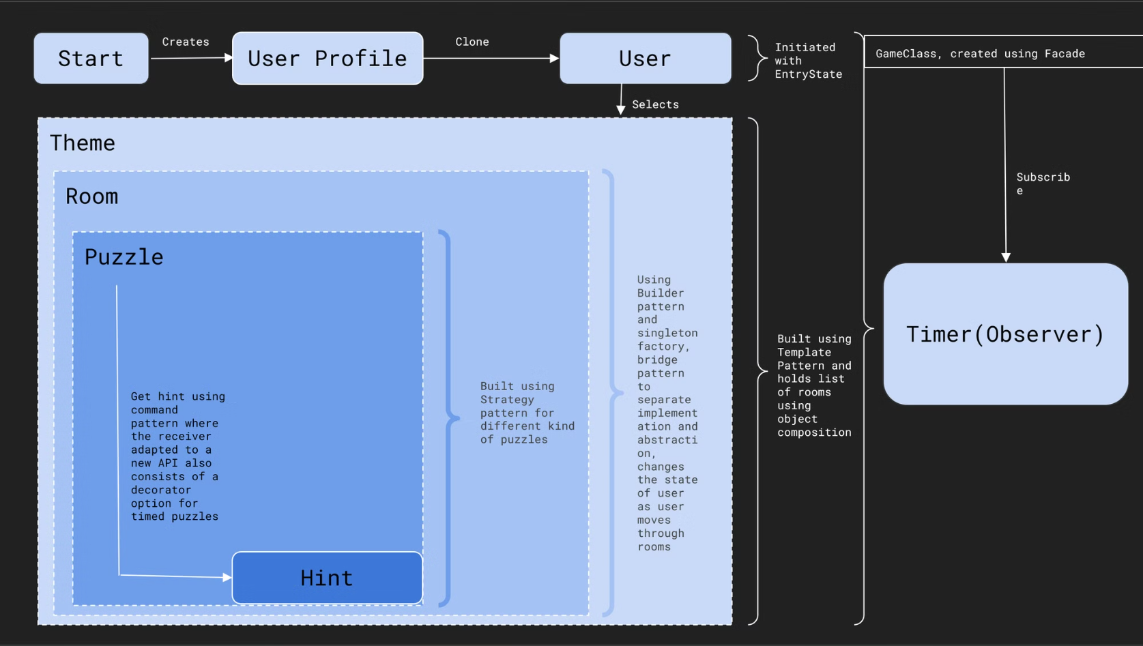
Design Architecture

Slide 4

Command Pattern: Encapsulating Requests
HintCommandAPI
HintInvokerAPI
Defines the interface for executing operations.
Asks the command to carry out the request.
HintReceiverAdapterAPI
PuzzleHintCommand
Adapts the receiver to the command interface.
Implements the command interface for puzzle hints.

Slide 5

Strategy Pattern: Interchangeable Algorithms
1
Define Strategy Interface
Create PuzzleStrategy interface to define common methods.
2
Implement Concrete Strategies
Develop MCQPuzzleStrategy and OneWordPuzzleStrategy classes.
3
Use in Context
Apply strategies interchangeably based on puzzle type.

Slide 6



Factory Pattern: Flexible Object Creation
Room Factory
Theme Factory
Puzzle Factory
The Room Factory creates different types of rooms for the game, allowing for a flexible and customizable experience.
The Theme Factory generates various themes for the puzzles and rooms, ensuring a diverse and engaging game environment.
The Puzzle Factory produces different types of puzzles, such as MCQ and One Word, to challenge players in unique and thought-provoking ways.

Slide 7




Singleton Pattern: Unique Instance Management
Eager Initialization
EagerSingletonHauntedMansion ensures a single instance is always available.
Lazy Initialization
LazySingletonCodingThemeFactory creates the instance only when needed.
Global Access
Both types provide a single point of access to the instance.

Slide 8





Observer Pattern: Event Notification System
Subject (Observable)
Observer Registration
Event Occurrence
Observer Update
Game start/end events trigger notifications.
Registered observers react to the notified events.
GameObservableTimer maintains a list of observers.
TimerObserver and others register for notifications.

Slide 9

Decorator Pattern: Dynamic Functionality Extension
1
Base Component
2
Concrete Component
The core puzzle interface defines basic functionality.
Implements the base puzzle interface.
3
Decorator
4
Additional Behavior
TimedPuzzleDecorator wraps the original puzzle.
Adds time-based challenges to puzzles dynamically.

Slide 10

State Pattern: Dynamic Behavior Modification
State
Description
EntryState
Initial game state for new players
BeginnerState
Early stages of gameplay
IntermediateState
Mid-level gameplay challenges
AdvancedState
Higher difficulty puzzles and rooms
ExitState
Final stage before game completion

Slide 11



Facade Pattern: Simplified Interface
Complex Subsystem
Facade Interface
Client Interaction
Intricate game logic and components work behind the scenes.
GameFacadeAPI provides a simplified interface for game control.
Clients interact with the game through the easy-to-use facade.

Slide 12

Builder Pattern: Step-by-Step Object Construction
1
Director
Oversees the construction process of complex objects.
2
Builder Interface
Defines the steps for creating parts of the product.
3
Concrete Builders
Implement the builder interface for specific object types.
4
Product
The complex object being constructed (e.g., Room, Puzzle, Theme).

Slide 13

Demo Time

Slide 14

Thank You
We greatly appreciate your time and attention.

